Slide 1

NeuroDOT 2.2.0 Base
Appendix - Pipeline Diagrams

Slide 2
High Level Diagrams
Pipeline figures with basic inputs and outputs

Slide 3
Diagram Legend
The initial input is a light orange box.
Orange circles describe metadata required for the function to work.
S-D Measurements
Each pipeline is in green.
Pre-Processing
Logmean Light Levels
High Pass Filter
“info” struct
Low Pass Filter 1
Browned-out shapes represent features planned for future releases.
Superficial Signal Regression
Individual steps are the boxes in red.
Low Pass Filter 2
Pre-processed light levels
Yellow boxes are the data being processed.

Slide 4
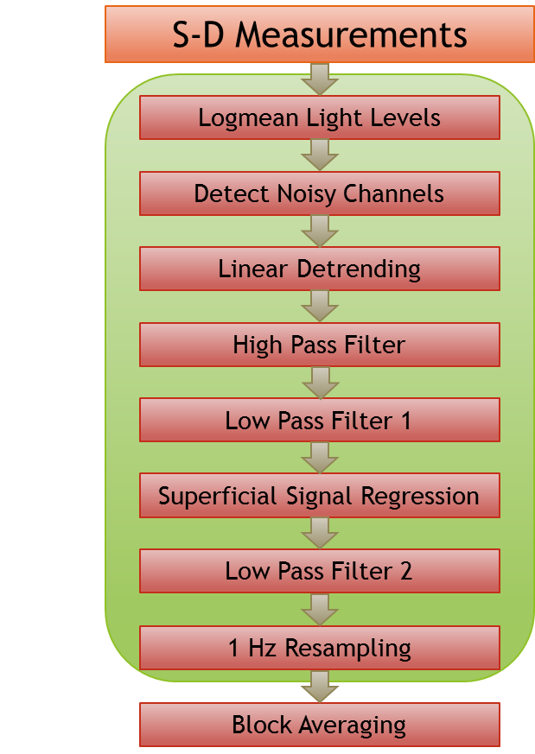
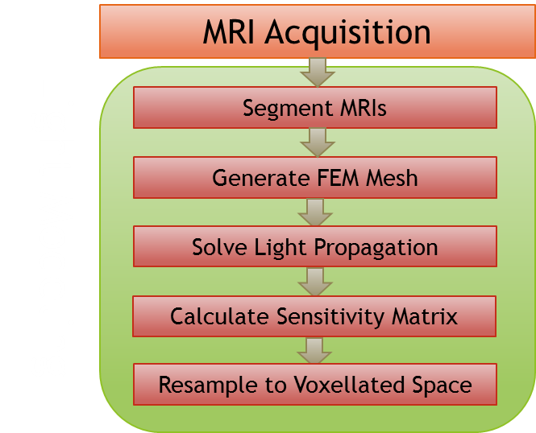
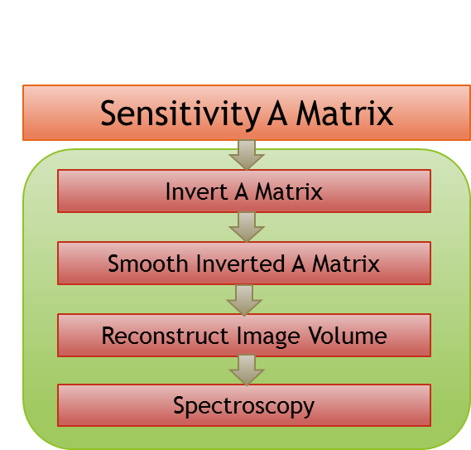
Overview

Slide 5
Converters - File IO
ND1 "data" and "info"
ND1 to ND2
Reshape "data"
Convert "info"
ND2 to ND1
Convert "info"
Reshape "data"
ND2 "data" and "info"

Slide 6
Multiple AcqDecode Files
AcqDecode - File IO
Raw File Name
Single AcqDecode File
Read Header
Raw AcqDecode file
Raw Folder Name
Raw AcqDecode file
Read Raw Data Stream
Discriminate # of Systems
AcqDecode key file
Read Key File
Load Individual Sub-folders
AcqDecode frame synch file
Read Frame Synch File
Crop Data to Synch Points (multi)
Compatibility Check
Combine Data Sets (multi)
Reshape Raw Data Streams
"data" array
"info" structure
Check for Missing Data
Read Auxiliary Files
AcqDecode aux channel file
Read Stimulus Synch Files
Acqdecode stim synch file
Load ND2 Pad File
ND2 Pad file
"data" array
"info" structure

Slide 7
Volumetric Data - Loading
File Name
Discriminate File Type
NIFTI
4dfp
Read NIFTI file
Read 4dfp *.ifh Header
Convert "nii" to 4dfp
Read 4dfp *.img File
Format for Output
Format for Output
"volume" array
"header" structure

Slide 8
Volumetric Data - Saving
"volume" array
"header" structure
"filename" save name
Discriminate File Type
NIFTI
4dfp
Format for Output
Format for Output
Convert to "nii" from 4dfp
Write "ifh" Header File
Save NIFTI File
Write "img" Image File
Saved File

Slide 9
HOMER - Loading and Saving
.nirs File
HOMER
Load .nirs File
Convert to ND2
(Work on data in ND2)
Convert to HOMER
Save .nirs File
.nirs File

Slide 10
Preprocessing
S-D Measurements
Preprocessing
“info” struct
Logmean Light Levels
Detect Noisy Channels
“info” struct
Linear Detrending
High Pass Filter
“info” struct
Low Pass Filter 1
“info” struct
Superficial Signal Regression
“info” struct
Low Pass Filter 2
“info” struct
“info” struct
1 Hz Resampling
Block Averaging
“info” struct
Preprocessed light levels

Slide 11
Reconstruction
Reconstruction
Sensitivity A Matrix
Invert A Matrix
Preprocessing Pipeline
Smooth Inverted A Matrix
Reconstruct Image Volume
Preprocessed light levels
Spectroscopy
Functional DOT Volume

Slide 12
Light Modeling
MRI Acquisition
Light Modeling
Segment MRIs
Generate FEM Mesh
Optode Positions
Solve Light Propagation
Calculate Sensitivity Matrix
Resample to Voxellated Space
Sensitivity A Matrix

Slide 13
Functional Diagrams
High level minus inputs and outputs, plus functional calls

Slide 14
Diagram Legend
Each function is in bold green.
Optional parameter inputs are in purple
S-D Measurements
Pre-Processing
Logmean Light Levels
info = FindGoodMeas(data, info, bthresh);
High Pass Filter
Low Pass Filter 1
The optical data or metadata structure inputs are in orange.
Superficial Signal Regression
Low Pass Filter 2

Slide 15
Converters - File IO
ND1 "data" and "info"
[data, info] = converter_ND1_to_ND2(data, info);
Reshape "data"
Convert "info"
info = converter_info(info, 'ND2 to ND1');
Convert "info"
Reshape "data"
data = converter_data(data, 'ND2 to ND1');
ND2 "data" and "info"
[data, info] = converter_ND2_to_ND1(data, info);

Slide 16
AcqDecode - File IO
Raw File Name
[data, info, synch, aux, framepts] = Load_AcqDecode_Data(filename);
Single AcqDecode File
Read Header
[Nd, Nd, Nwl, Nt] = Read_AcqDecode_Header(fid);
Read Raw Data Stream
Read Key File
info = ReadInfoTxt(filename);
Read Frame Synch File
Compatibility Check
Reshape Raw Data Streams
Check for Missing Data
[data, info, framepts] = Check4MissingData(data, info, framepts);
Read Auxiliary Files
aux = ReadAux(info, path, file);
Read Stimulus Synch Files
synch = InterpretStimSynch(aux, framepts, info);
[synchpts, synchtype] = InterpretSynchBeeps(synch);
info.paradigm = InterpretPulses(info.paradigm);
Load ND2 Pad File

Slide 17
Multiple AcqDecode Files
AcqDecode - File IO
Raw Folder Name
Discriminate # of Systems
Load Individual Sub-folders
[data, info, synch, aux, framepts] = Load_AcqDecode_Data(filename, path, flags);
Crop Data to Synch Points (multi)
data = Crop2Synch(data, synchpts);
Combine Data Sets (multi)
"data" array
"info" structure

Slide 18
Volumetric Data - Loading NIFTI
File Name
[volume, header] = LoadVolumetricData(filename, pn, file_type);
Discriminate File Type
NIFTI
Read NIFTI file
nii = load_nii(full_filename);
Convert "nii" to 4dfp
header = Read_NIFTI_Header(nii);
Format for Output
"volume" array
"header" structure

Slide 19
Volumetric Data - Loading
File Name
[volume, header] = LoadVolumetricData(filename, pn, file_type);
Discriminate File Type
4dfp
Read 4dfp *.ifh Header
header = Read_4dfp_Header(full_filename);
Read 4dfp *.img File
Format for Output
"volume" array
"header" structure

Slide 20
Volumetric Data - Saving
"volume" array
"header" structure
"filename" save name
SaveVolumetricData(volume, header, filename, pn, file_type);
Discriminate File Type
NIFTI
Format for Output
Convert to "nii" from 4dfp
nii = Write_NIFTI(volume, header, full_filename);
Save NIFTI File
save_nii(nii, full_filename);
Saved File

Slide 21
Volumetric Data - Saving
"volume" array
"header" structure
"filename" save name
SaveVolumetricData(volume, header, filename, pn, file_type);
Discriminate File Type
4dfp
Format for Output
Write "ifh" Header File
Write_4dfp_Header(header, full_filename);
Write "img" Image File
Saved File

Slide 22
HOMER - Loading and Saving
.nirs File
HOMER
Load .nirs File
[data, info] = Load_HOMER(filename, pn);
Convert to ND2
[data, info] = converter_HOMER_to_ND2(nirs);
(Work on data in ND2)
Convert to HOMER
nirs = converter_HOMER_to_ND2(data, info);
Save .nirs File
Save_HOMER(data, info, filename, pn);
.nirs File

Slide 23
Preprocessing
S-D Measurements
Preprocessing
Logmean Light Levels
lmdata = logmean(data);
Detect Noisy Channels
info = FindGoodMeas(lmdata, info);
Linear Detrending
ddata = detrend_tts(lmdata);
High Pass Filter
hpdata = highpass(ddata, flags.omega_hp, info.system.framerate);
Low Pass Filter 1
lp1data = lowpass(hpdata, flags.omega_lp1, info.system.framerate);
Superficial Signal Regression
hem = gethem(lp1data, info); SSRdata = regcorr(lp1data, info, hem);
Low Pass Filter 2
lp2data = lowpass(SSRdata, flags.omega_lp2, info.system.framerate);
1 Hz Resampling
[rdata, info] = resample_tts(lp2data, info, flags.omega_resample, flags.resample_tol);
Block Averaging
badata = BlockAverage(rdata, info, 2);

Slide 24
Reconstruction
Sensitivity A Matrix
Reconstruction
Invert A Matrix
iA = Tikhonov_invert_Amat(A, flags.lambda1, flags.lambda2);
Smooth Inverted A Matrix
siA = smooth_Amat(iA, info, dim, flags.gbox, flags.gsigma);
Reconstruct Image Volume
cortex_mua = reconstruct_img(preprocessed, siA);
Spectroscopy
cortex_Hb = spectroscopy_img(cortex_mua, E);

Slide 25
Data Structures
Variables contained in all sample files

Slide 26
Data Structures
There are three variables in the sample file “NeuroDOT_Base_HW_Sample_1.mat”:
data – A “MEASUREMENTS x TIME” array of raw optical light-level measurements acquired from a study participant during a hearing words test.
info – A structure array containing metadata about cap information like wavelengths, topography, the system, experimental scheme, and the light model, which are required to convert the raw light-level measurements into 3D time series (AKA movies) of brain activity.
flags - A structure array containing instructions for functions in the pipeline.

Slide 27
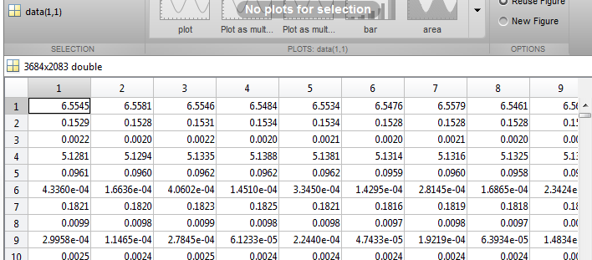
Data Structures: data
Each row of data corresponds to a source-detector pair. Each column is one frame or sample of the acquisition period.

Slide 28
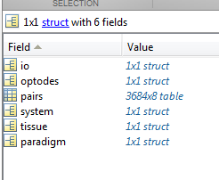
Data Structures: info
There are eight fields in info:
io - (optional) Information loaded during file IO but not used in ND2.
system - Metadata of system used to collect scan data from cap.
paradigm - Metadata describing experimental design.
pairs - Table describing source-detector measurements.
optodes - Geometry of imaging cap.
tissue - Information about light modeling.
MEAS - ("on-the-fly") A table of data generated along MEAS dimension.
misc - (optional) Information kept from ND1 structures during file conversion.

Slide 29
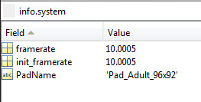
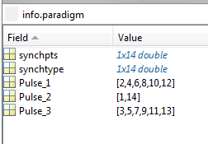
In Detail: info.system and info.paradigm
info.system
PadName - Name of the Pad_[xxxx].mat file used to create info.pairs, info.optodes, and info.tissue.
framerate - Current framerate of data being processed.
init_framerate - Original framerate of data at time of acquisition.
info.paradigm
synchpts - Time points of synch pulses detected.
init_synchpts - A backup of the original synch points.
synchtype - Frequency of the pulses detected.
Pulse_1 - Indices of session start and stop times within synchpts
Pulse_2 – Indices of block start times within synchpts
Pulse_3/Pulse_4 – Indices of extra stimuli or rest pulses within synchpts.

Slide 30
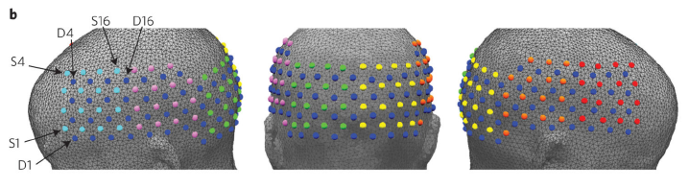
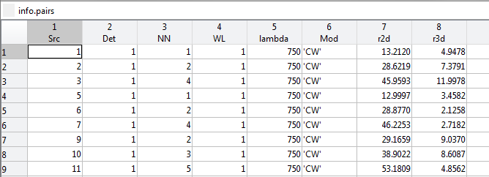
In Detail: The info.pairs table
Each row represents a measurement.
The columns are:
Src – Source number
Det – Detector number
NN – Nearest neighbor topology
WL – Wavelength number
lambda - Wavelength in nm
Mod - Modulation scheme
r2d – S-D pair radius on a 2D grid
r3d - S-D pair radius in 3D wrapped cap space
NN1
NN2
NN3
NN4
NN5

Slide 31
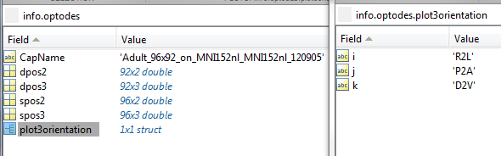
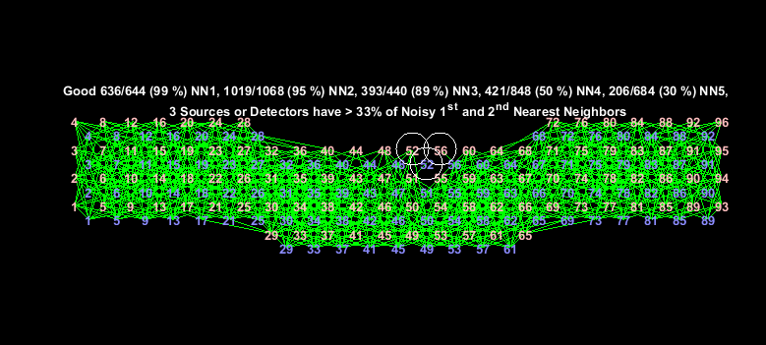
In Detail: info.optodes
CapName - Name of cap file used.
dpos2 - Detector positions in 2D grid space.
spos2 - Source positions in 2D grid space.
dpos3 - Detector positions in 3D wrapped cap space.
spos3 - Source positions in 3D wrapped cap space.
plot3orientation - Contains .i, .j, and .k fields corresponding to x, y, and z orientation of 3D wrapped cap space.
Left: 2D grid space.
Right: 3D wrapped cap space.

Slide 32
In Detail: info.tissue
info.tissue
affine - A transform matrix relating the DOT space to the atlas space.

Slide 33
Data Structures: flags
The flags structure has 11 fields:
Nsys - Number of systems used to acquire data.
crop_level - Determines data cropping to synch points. 0 – none, 1 – start pulse, 2 – start and stop pulses. Default 0 for Nsys == 1, and 2 for Nsys >= 2.
bthresh – Noise threshold for Good Measurements analysis.
gbox – Gaussian smoothing filter width.
gsigma – Gaussian smoothing filter height.
lambda1 – First Tikhonov regularization parameter.
lambda2 – Spatially variant Tikhonov regularization parameter.
omega_hp – HPF frequency.
omega_lp1 – First LPF frequency.
omega_lp2 – Second LPF frequency.
omega_lp3 – Third LPF frequency.
omega_resample – Resampling frequency.
resample_tol – Tolerance threshold for resampling ratio

Slide 34
Data Structures: params & header
params is used by most of the visualizations in NeuroDOT 2. Please see the appendix section at the end of this presentation, the function help sections, or the User Manual index for details on which functions use which fields.
header is the NeuroDOT 2 native 4dfp format header for volumetric data.

Slide 35
Data Structures: params (1)
params
fig_size - Figure position vector.
fig_handle - Figure to target.
dimension - Plot rendering dimension.
rlimits - Limits of pair radii displayed.
Nnns - Number of NN's displayed.
Nwls - Number of WL's displayed.
useGM – Whether to use Good Measurements.
xlimits – Y-axis limits.
xscale – X-axis scaling.
ylimits – Y-axis limits.
yscale – Y-axis scaling.
climits - Limits of color axis.
mode – Display mode.
Nregs - Number of mesh regions to display.
cbmode - Use custom colorbar axis labels.
cblabels - Custom colorbar axis labels.
cbticks - Custom colorbar axis label ticks.
bins - Number or array of histogram bins.
show_pulses - Whether to display stim synch pulses.

Slide 36
Data Structures: params (2)
params
CH - Turn crosshairs on and off.
slices - Selects 3D slices to display.
slices_type - Selects MATLAB indexing or coordinates in provided space for slices.
orientation - Selects 3D orientation to display.
view – Sets the view perspective.
ctx – Defines inflation of a mesh.
alpha – Transparency of mesh.
OL – If “overlap” data is presented (OL==1), this sets the interpolation method to 'nearest'. Default is 'linear'.
DR - Grayscale dynamic range.
Scale - Maximum value to which an image is scaled.
BG - Background color, as an RGB triplet.
TC - True color mapping.
PD - Declares a positive definite data set.
Cmap - Colormap settings.
P - Positive domain colormap.
N - Negative domain colormap.
flipP - Inverts positive colormap.
flipN - Inverts negative colormap.
Th - Threshold settings structure.
P - Basemum threshold to display positive values.
N - Maximum threshold to display negative values.
Saturation - Field the size of data with values to set the coloring saturation. Must be within range [0, 1].

Slide 37
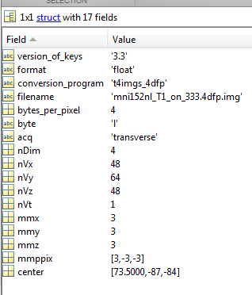
Data Structures - header
header
version_of_keys - Key file version.
format - Format of raw data file (“float”, “double”, etc.).
conversion_program - Program used to convert the space.
filename - Name of associated raw volumetric data file.
bytes_per_pixel - Number of bytes per pixel.
byte - Byte endian-ness.
acq - Canonical orientation of the data's raw space.
nDim - Number of dimensions.
nVx, nVy, nVz - Number of voxels in each spatial dimension.
nVt - Number of time points.
mmx, mmy, mmz - Size of voxels in millimeters, in each dimension.
mmppix - Number of millimeters per voxel in each dimension (x, y, z). A negative value reflects that the direction is flipped in that dimension.
center - A vector projecting from the center of voxel (0, 0, 0) to the center of the space described by header.

Slide 38
Data Structures - mesh
mesh - A 3D surface mesh object
nodes - A NODES x 3 column vector where each row represents the X, Y, and Z coordinates of a polygon vertex on the surface.
elements - An ELEMENTS x 3 column vector where each row represents the index of three NODES that create a polygon in 3D space.
data - An optional NODES x 1 array containing an interpolation of volumetric data at each node.
region – An optional NODEs x 1 array of region labels.

Slide 39
Data Structures - ops
ops – A structure containing results from the Cap_Fitter GUI.
rot_x, rot_y, rot_z – Rotation angles in each spatial dimension.
trans_x, trans_y, trans_z – Translation in each spatial dimension.
flip_x, flip_y, flip_z – Flip axes in each spatial dimension.
scale_m – Scaling factor.

Slide 40
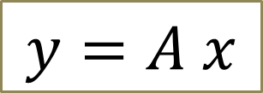
Data Structures
$$y=A x$$
The NeuroDOT 2 file A_Adult_96x92.mat contains several variables for reconstuction:
A - A MEAS x VOX sized pre-determined sensitivity matrix.
dim - A structure describing the DOT reconstruction space.
infoA - A 4dfp header describing the sensitivity modeling space.

Slide 41
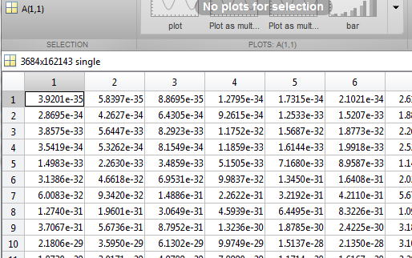
Data Structures - A
Each row of A corresponds to a measurement channel in data.
Each column in A corresponds to a voxel in the reconstruction space described by dim.

Slide 42
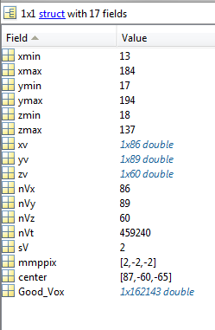
Data Structures - dim
dim
xmin, xmax, ymin, ymax, zmin, zmax - Min and max coordinates in each dimension of the sensitivity matrix space.
xv, yv, zv - Coordinates of each voxel along each dimension.
nVx, nVy, nVz - Number of voxels in each dimension.
nVt - Total number of voxels in the space.
sV - Isometric voxel size, in millimeters.
mmppix - Number of millimeters per voxel in each dimension (x, y, z). A negative value reflects that the direction is flipped in that dimension.
center - A vector projecting from the center of voxel (0, 0, 0) to the center of the space described by dim.
Good_Vox - Voxels of the full cuboid volume described by dim that are populated with data in the associated data array.

Slide 43
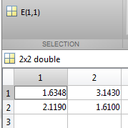
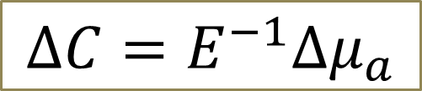
Data Structures
The last thing we'll need is a matrix of spectroscopy constants to satisfy the modified Beer-Lambert law.
This is stored in: /Support_Files/Raw_Support_Files/Spectroscopy/E.mat The lone variable, E, is a 2 x 2 (WL x HB) matrix of spectroscopy constants for HbO and HbR.
$$∆C=E^{−1}∆μ_{a}$$

Slide 44
Function Descriptions
In this section, the functions of each folder are listed and described.

Slide 45
Analysis
Name | Purpose
BlockAverage | Averaging of stimulus blocks.
FindGoodMeas | Filter out noisy channels.

Slide 46
File IO (1)
Name | Purpose
Check4MissingData | Validates framesynch file against key file info.
Crop2Synch | Crops data to synch points.
converter_data | Reshapes data from ND1 to ND2 format.
converter_HOMER_to_ND2 | Converts workspace from HOMER to ND2.
converter_info | Converts the ND1 info structure to ND2 format.
converter_ND1_to_ND2 | Converts both data and info from ND1 format to ND2.
converter_ND2_to_HOMER | Converts workspace from ND2 to HOMER.
converter_ND2_to_ND1 | Converts both data and info from ND2 format to ND1.
Crop2Synch | Crops data to synch points.
InterpretStimSynch | Reads stimulus from frame synch file.
InterpretSynchBeeps | Automated synch file analysis.
Load_AcqDecode_Data | Loads a single AcqDecode file.
Load_HOMER | Converts and loads a HOMER2 ".nirs" file into ND2.

Slide 47
File IO (2)
Name | Purpose
LoadMulti_AcqDecode_Data | Loads and combines data from multiple AcqDecode files for a single scan.
LoadVolumetricData | Loads a volumetric data file.
Make_NativeSpace_4dfp | Calculates native space of incomplete 4dfp header.
Read_4dfp_Header | Reads the .ifh header of a 4dfp file.
Read_AcqDecode_Header | Interprets the header of an AcqDecode generated data file.
Read_NIFTI_Header | Reads a NIFTI file header.
ReadAux | Reads auxiliary channel files.
ReadInfoTxt | Reads a key file.
Save_HOMER | Converts an ND2 workspace to HOMER2 ".nirs" format to save.
SaveVolumetricData | Saves volumetric data in supported formats.
Write_4dfp_Header | Writes a 4dfp header.
Write_NIFTI | Prepares a "nii" structure to be written to file.

Slide 48
GUIs
Name | Purpose
Cap_Fitter | A GUI to display and orient the cap grid onto the head mesh.
operate_optodes | Performs the Cap_Fitter operations on a cap grid.
springfit_optodes | Applies a spring fit calculation to placing optodes on the head.

Slide 49
Reconstruction
Name | Purpose
reconstruct_img | Performs image reconstruction by wavelength using inverted A-matrix.
smooth_Amat | Performs Gaussian smoothing on a sensitivity matrix.
spectroscopy_img | Completes the Beer-Lambert law from a reconstructed image.
Tikhonov_invert_Amat | Inverts a sensitivity matrix.

Slide 50
Spatial Transforms
Name | Purpose
affine3d_img | Transforms a 3D data set to a new space.
change_space_coords | Applies a look up to change 3D coordinates into a new space.
Good_Vox2vol | Turns a Good Voxels data stream into a volume.
rotate_cap | Rotates the cap in space.
rotation_matrix | Creates a rotation matrix.
scale_cap | Scales a cap grid.

Slide 51
Support
Name | Purpose
CheckOrientation | Interprets 3D orientation information.
istablevar | Same operation as “isfield” for tables.

Slide 52
Temporal Transforms
Name | Purpose
detrend_tts | Performs linear detrending.
fft_tts | Fast Fourier Transform function with normalization and multiple outputs.
gethem | Generate hemodynamics for SSR.
highpass | High pass filter.
logmean | Negative logarithm of each channel divided by its mean.
lowpass | Low pass filter.
normalize2range_tts | Normalizes time traces to average of a range.
regcorr | SSR to remove hemodynamics from data.
resample_tts | Resample data while maintaining linear signal component.

Slide 53
Visualizations (1)
Name | Purpose
adjust_brain_pos.m | Repositions mesh orientations for display.
applycmap.m | Performs color mapping and fuses images with anatomical models.
PlotCap.m | A visualization of the cap grid.
PlotCapData.m | A basic plotting function for generating and labeling cap grids.
PlotCapGoodMeas.m | A Good Measurements visualization overlaid on a cap grid.
PlotCapMeanLL.m | A visualization of mean light levels overlaid on a cap grid.
PlotFalloffData.m | A basic falloff plotting function.
PlotFalloffLL.m | A light-level falloff visualization.
PlotGray.m | A visualization of data as a scaled image.
PlotGrayData.m | A basic scaled image plotting function.
PlotHistogramData.m | A basic histogram plotting function.
PlotHistogramSTD.m | A histogram of channel standard deviations.

Slide 54
Visualizations (2)
Name | Purpose
PlotInterpSurfMesh.m | Interpolates volumetric data onto hemispheric meshes for display
PlotLRMeshes.m | Renders a pair of hemispheric meshes.
PlotMeshSurface.m | Shows a head mesh model's outer surface.
PlotPowerSpectrumAllMeas.m | An all-measurements frequency-domain time trace visualization.
PlotPowerSpectrumData.m | A basic frequency-domain time traces plotting function.
PlotPowerSpectrumMean.m | A mean frequency-domain time trace visualization.
PlotSlices.m | Creates an interactive three-slice plot.
PlotSlicesMov.m | Creates a video file from a volumetric data set.
PlotSlicesTimeTrace.m | Creates an interactive 4D plot.
PlotTimeTraceAllMeas.m | An all-measurements time trace visualization.
PlotTimeTraceData.m | A basic time traces plotting function.
PlotTimeTraceMean.m | A mean time traces visualization.
vol2surf_mesh.m | Interpolates volumetric data onto a surface mesh.

Slide 55
Appendix: params Usage
 | params
 | fig_size | fig_handle | dimension | rlimits | Nnns | Nwls | useGM | xlimits | xscale | ylimits | yscale | climits | mode | Nregs | cbmode | cblabels | cbticks | bins | CH | slices | slices_type | orientation | view | ctx | alpha | OL | DR | Scale | BG | TC | PD | Cmap.P | Cmap.N | Cmap.flipP | Cmap.flipN | Th.P | Th.N | Saturation | kernel
Function Name
adjust_brain_pos |  |  |  |  |  |  |  |  |  |  |  |  |  |  |  |  |  |  |  |  |  | X | X | X
applycmap.m |  |  |  |  |  |  |  |  |  |  |  |  |  |  |  |  |  |  |  |  |  |  |  |  |  |  | X | X | X | X | X | X | X | X | X | X | X | X
PlotCap | X | X | X
PlotCapData.m | X | X | X |  |  |  |  |  |  |  |  |  | X
PlotCapGoodMeas.m | X | X | X | X | X | X |  |  |  |  |  |  | X
PlotCapMeanLL | X | X | X | X | X | X | X |  |  |  |  |  |  |  |  |  |  |  |  |  |  |  |  |  |  |  |  |  |  |  |  | X
PlotFalloffData.m | X | X |  |  |  |  |  | X | X | X | X
PlotFalloffLL.m | X | X | X | X | X | X | X | X | X | X | X
PlotGray.m | X | X | X | X | X | X | X |  |  |  |  | X
PlotGrayData.m | X | X |  |  |  |  |  |  |  |  |  | X
PlotHistogramData.m | X | X |  |  |  |  |  | X |  | X |  |  |  |  |  |  |  | X
PlotHistogramSTD.m | X | X | X | X | X | X |  | X |  | X |  |  |  |  |  |  |  | X
PlotInterpSurfMesh |  |  |  |  |  |  |  |  |  |  |  |  |  |  |  |  |  |  |  |  |  |  |  |  |  |  |  | X |  |  |  |  |  |  |  | X | X
PlotLRMeshes | X | X |  |  |  |  |  |  |  |  |  |  |  |  |  | X | X |  |  |  |  |  | X |  | X |  |  | X |  |  | X
PlotMeshSurface | X | X |  |  |  |  |  |  |  |  |  |  |  | X |  |  |  |  |  |  |  | X |  |  |  |  |  |  | X | X |  | X
PlotPowerSpectrumAllMeas.m | X | X | X | X | X | X | X | X | X | X | X
PlotPowerSpectrumData.m | X | X |  |  |  |  |  | X | X | X | X
PlotPowerSpectrumMean.m | X | X | X | X | X | X | X | X | X | X | X
PlotSlices.m | X | X |  |  |  |  |  |  |  |  |  |  |  |  | X | X | X |  | X | X | X | X |  |  |  |  |  | X |  |  | X
PlotSlicesMov.m | X | X
PlotSlicesTimeTrace.m | X | X |  |  |  |  |  |  |  |  |  |  |  |  | X | X | X |  | X | X | X | X |  |  |  |  |  | X |  |  | X |  |  |  |  |  |  |  | X
PlotTimeTraceAllMeas.m | X | X | X | X | X | X | X | X | X | X | X
PlotTimeTraceData.m | X | X |  |  |  |  |  | X | X | X | X
PlotTimeTraceMean.m | X | X | X | X | X | X | X | X | X | X | X
vol2surf_mesh |  |  |  |  |  |  |  |  |  |  |  |  |  |  |  |  |  |  |  |  |  |  |  |  |  | X

Slide 56
That’s It (For Now)
For further questions or more information, please consult the NeuroDOT 2 Base User Manual and the various Appendices.
NeuroDOT 2 Team:
Adam Eggebrecht (aeggebre@wustl.edu)
David Muccigrosso (muccigrosso.david@wustl.edu)

